Slide 1
Weather and Climate
Notes:
25 slides

Slide 2
What is Weather?
Weather is how hot or cold or sunny or rainy it is outside
Notes:
TEACHER NOTES: -Before showing the slide, ask kids what their definition of weather is
-Ask to give examples of types of weather

Slide 3
The weather is
always changing!

Slide 4
How about climate?
Climate and weather
are NOT the same!

Slide 5
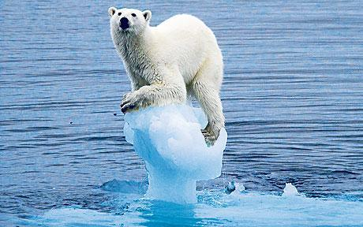
Climate is how hot or cold, sunny or rainy it is outside in a BIG area over a LONG time
Notes:
TEACHER NOTES: -Give examples of different climates; ie. The climate in Antarctica is always cold and snowy

