Slide 1
Grade 5 Properties and Structure of Matter
Steven Tran and Brian Tran

Slide 2
What is Matter?
Matter is anything that takes up space, has mass and is made of atoms
Mass- the amount of matter in an object
Notes:
tell students to look around the room and observe matter

Slide 3
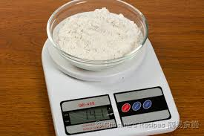
Mass
Mass is measured by “grams”
A kilogram = 1000 grams

Slide 4
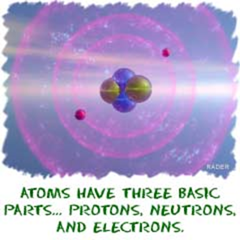
Atom
The basic unit of matter and the building blocks of things.
Too small to be seen by the
naked eye and requires a
microscope to view atoms

Slide 5
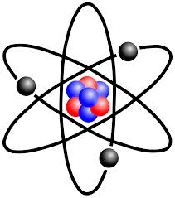
Atom
An atom is made of protons, neutrons and electrons.
Notes:
Tell that protons are postive charge
neutrons are no charged
and electrons are negative charged

Slide 6
The nucleus is the middle of the atom and is made of protons and neutrons
The rings around the atom are the electrons

Slide 7
Element
An atom that has a certain amount of protons.
Example
Hydrogen is an atom that has one proton
Helium is an atom that has two protons

Slide 8
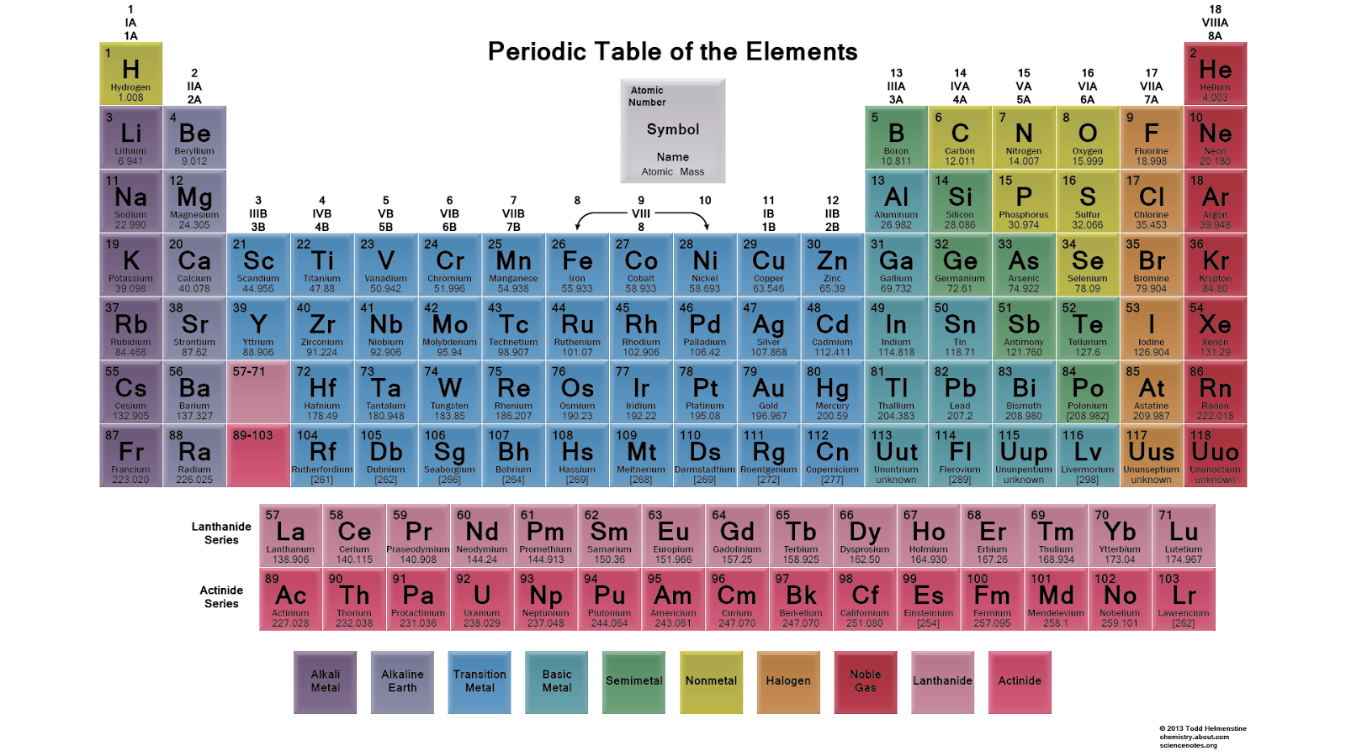
Periodic Table of the Elements
A diagram showing all the elements known to man in order of the protons.
Notes:
Ask students if they know any of the elements in the periodic table.
Read left to right
up to down

Slide 9
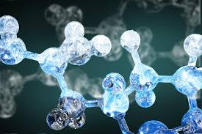
Molecule
A group of atoms held together by bonds
Example: Water (H2O Two Hydrogen + 1 Water)
Compound - A molecule
with two more more
elements
Notes:
Say that Compounds have 2 more elemnets while molecules can have 1.
O2 is not a compound because it only has oxygen
All compouds are molecules but not all molecules are compounds

Slide 10
Question 1
Name the three things that makes up an atom.
Notes:
Protons, electrons, neutrons

Slide 11
Question 2
Is Oxygen Air ( O2 ) a compound?
Notes:
No because it only has one element: oxygen

Slide 12
Question 3
What element has 5 protons?
Notes:
Boron

Slide 13
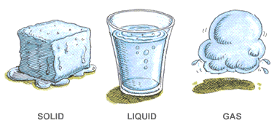
States of Matter
State - the form in which matter exist

Slide 14
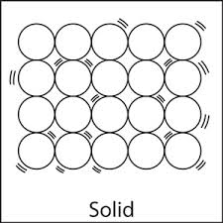
Solid
Particles are tight
definite shape

Slide 15
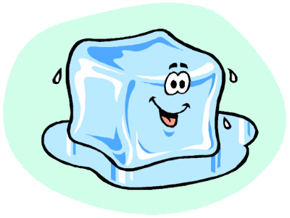
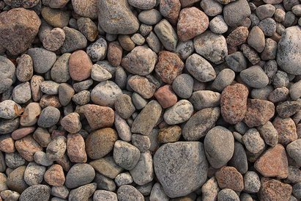
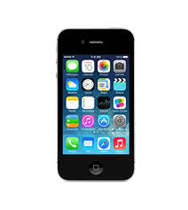
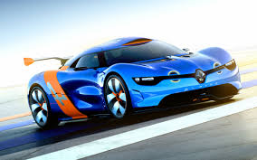
Examples of Solids
Notes:
examples of solids
1) ice
2) rocks
3) iphone
4) car
ask students to tell if they know any other solids

Slide 16
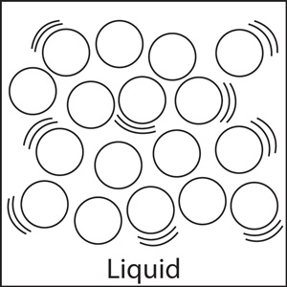
Liquid
no definite shape
particles are loosely tight
takes the shape of its container

Slide 17
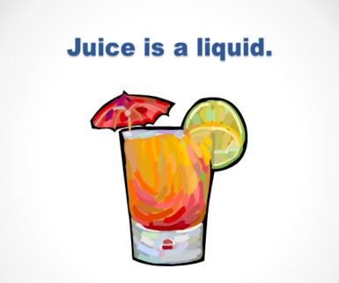
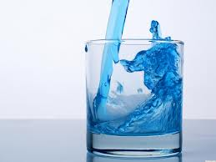
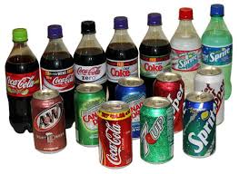
Examples of Liquid
Notes:
1) water
2) juice
3) carbonated drinks
ask students if they know other liquids

Slide 18
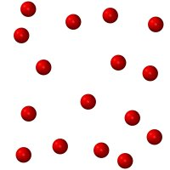
Gas
no definite shape
also takes the shape as its container
particles are spreaded

Slide 19
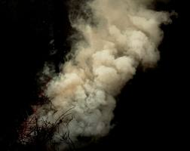
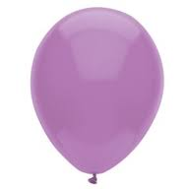
Examples of Gas
Notes:
1) air
2) smoke
3) gas in ballon
ask students if they know any other gas

Slide 20
State Definite Shape Definite Volume
Solid YES YES
Liquid NO YES
Gas NO NO
Notes:
Explain this chart.
Use examples like a pencil saying how the shape will always be the same while water in a water bottle shape can change.

Slide 21
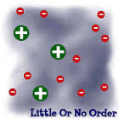
The 4th Matter
Plasma is the 4th state of matter
It is like Gasses but the particles are made of free electrons

Slide 22
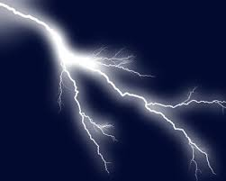
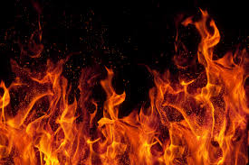
Examples of Plasma
Notes:
1) fire
2) lightning
3) neon lights

Slide 23
Absolute Zero
The atoms in matter vibrates even though you can not see it vibrates.
Absolute Zero is the degrees that atoms can not move at all
It is at -273.15 Celsius or −459.67 Fahrenheit

Slide 24
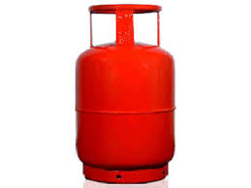
What state is this?
Question 1
(Inside)
Notes:
Gas

Slide 25
What is this state?
Question 2
Notes:
Liquid

Slide 26
Question 3
State Definite Shape Definite Volume
Solid YES
Liquid NO
Gas
Fill in the blank
Notes:
YES NO
NO NO

Slide 27
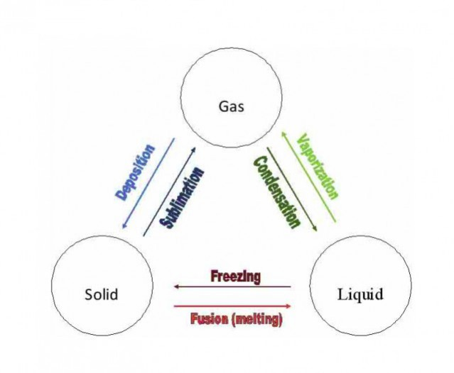
State changes
Changing from one state to another state
(liquid - gas )
-matter can change phases by adding heat or by removing heat.

Slide 28
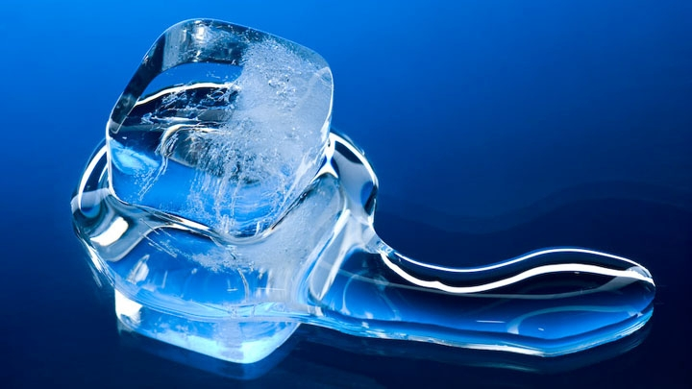
Melting - going from solid to liquid
(Ice -> water)
Notes:
ask students for other examples of melting or tell them more
rocks - magma

Slide 29
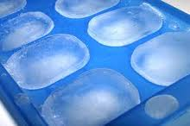
Freezing - going from liquid to solid
(water -> ice)
Notes:
Tell students or ask them for more examples

Slide 30
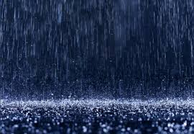
Condensation- going from gas to liquid
(clouds - rain)

Slide 31
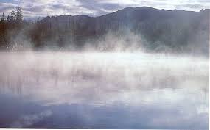
Evaporation-going from liquid to gas
(water - water vapor)

Slide 32
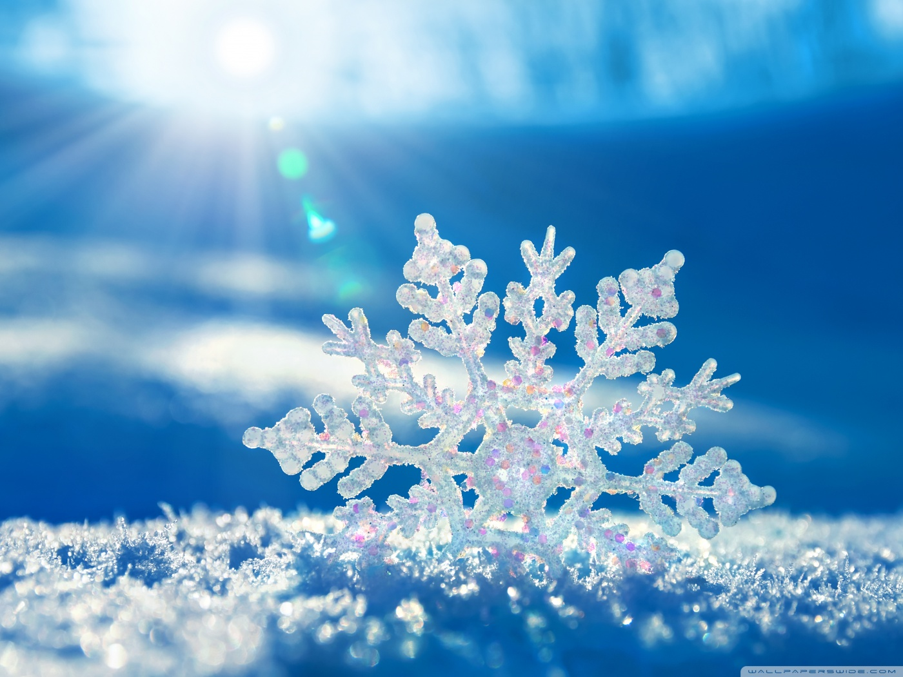
Deposition - going from gas straight to solid without going in a liquid state in between
(cloud - snow)

Slide 33
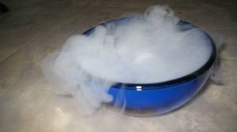
Sublimation- going from gas to solid without entering the liquid state
(Water vapor → ice

Slide 34
Phase changes
do not change the substance but just change the motion
(water and ice are the same)
more heat = more movement of molecules
less heat = less movement of molecules

Slide 35
Phases that heat Phases that heat is
is added removed
Melting
Evaporation
Sublimation
Freezing
Condensation
Deposition
Notes:
Refer to previous slide that more heat = more movement.
Tell students that adding heat makes it go like this solid → liquid → gas while losing heat makes that cycle go reverse

Slide 36
Question 1
What is Melting?
Notes:
Going from Solid to liquid

Slide 37
Question 2
What two things can cause state changes?
Notes:
adding heat and removing heat

Slide 38
Question 3
What is the order of states
from low energy to high energy?
Notes:
Solid → Liquid → Gas

Slide 39
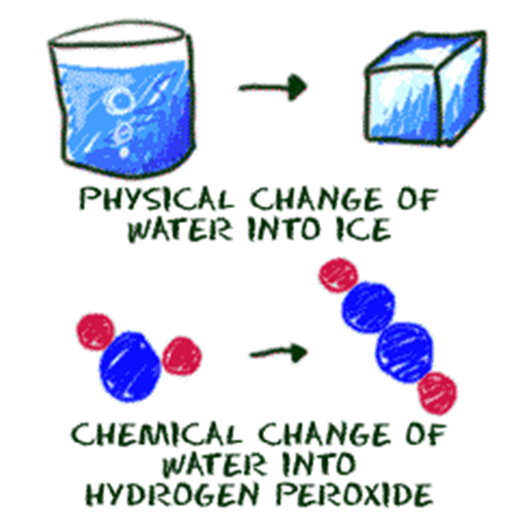
Changes of Matter
There are two types are changes
Physical Changes
Chemical Changes

Slide 40
Physical Change
Physical Change- A change to the matter on how it looks but not change the matter completely
Examples - cutting, coloring,
Notes:
Tell that phase changes are physical change

Slide 41
Chemical Change
Changes the composition of the matter
Example: burning paper changes the matter of the paper to crisp dust
Not easily reversed or reversible (you can not revert crisp dust back to paper
Notes:
ask for other chemical change other than burning

Slide 42
Mixture
A mixture is a compound made of two matter than is not combined chemically
Examples
Salad ( leaves- dressing) Cereal ( milk - cereal)
Salt Water ( Salt + Water)

Slide 43
Solution
- a liquid mixture in which the minor component dissolves into the major component and is spread throughout
Examples
Saltwater ( salt - minor ; water- major)
Syrup ( sugar - minor; water - major)
Vinegar (acid - minor; water - major)
Notes:
Explain the difference between mixture and solution
1.In a solution, the substances are dissolved while in a mixture the substances are mixed up but they are not completely dissolve

Slide 44
Question 1
What of these are not a
Physical Change
Coloring Burning
Cutting Breaking

Slide 45
Question 2
What of these are not a
Chemical Change
Rusting Burning
Cutting Cooking

Slide 46
Properties of Matter
A description about the certain matter that can be measured or observed.

Slide 47
Things to think about
How It Looks (Shiny ,Dull, Color, etc.)
How It Feels (Hard, Soft, Rough , Smooth, etc.)
How It Smells (Sweet, Sharp, Terrible, No Smell, etc.)
How It Sounds (Loud, Soft, Echo, No Sound, etc.)
What It Does (Bounce, Stretch, Tear, Break, Magnetism etc.)

Slide 48
Color
We can use color to identify different matter
rock ( gray to brown)
sky ( blue to gray in stormy nights) fire ( red ) ocean ( deep blue)

Slide 49
Size
Some matter are bigger than others
A normal size pencil is smaller than a desk
A baseball ball is smaller than a basketball

Slide 50
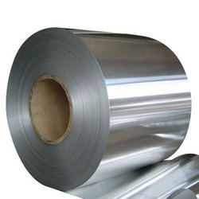
Malleability
Malleability is a property in which it measures how good that matter can be smashed down
Clay can be smashed to be thin while bricks will break if a hammer smash it

Slide 51
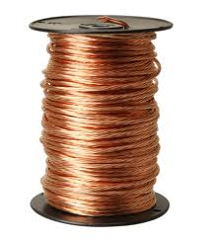
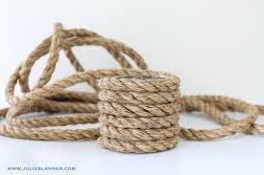
Ductility
Measures how a certain matter can be stretched and pulled
Notes:
Copper wire is made by stretching copper
rope can be pulled
Ask students what can be stretched and what can not be stretched

Slide 52
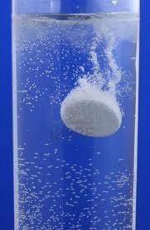
Solubility
How well can a certain matter dissolve in
water
Notes:
Example
salt
sugar
other liquids
what cant
bricks
any thick solid

Slide 53
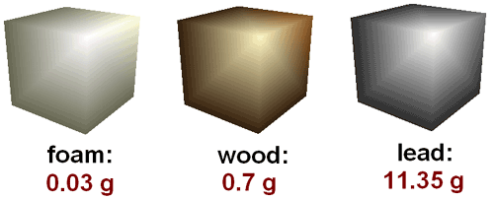
Density
The amount of mass per volume
D = Mass ÷ Volume

Slide 54
Thermal Conductivity
How well can a material conduct heat.
Examples
Metal ( become hot if expose to a heat source)

Slide 55
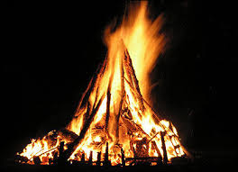
Flammability
How well can the certain matter be set on fire
Notes:
examples
wood
paper
cloth
leaves
what cant
bricks
stone

Slide 56
THINK OF A PROPERTY THAT WAS NOT LISTED!!!

Slide 57
absorption
albedo
area
brittleness
boiling point
capacitance
color
concentration
density
dielectric constant
ductility
distribution
efficacy
electric charge
electrical conductivity
electrical impedance
electrical resistivity
electric field
electric potential
emission
flexibility
flow rate
fluidity
frequency
inductance
intrinsic impedance
intensity
irradiance
length
location
luminance
luster
malleability
magnetic field
magnetic flux
mass
melting point
moment
momentum
permeability
permittivity
pressure
radiance
solubility
specific heat
resistivity
reflectivity
spin
strength
temperature
tension
thermal conductivity
velocity
viscosity
volume
wave impedance
Notes:
Explain to student if they do not know any of of the terms
dielectric constant - a quantity measuring the ability of a substance to store electrical energy in an electric field.
Electrical impedance - is the measure of the opposition that a circuit presents to a current when a voltage is applied.

Slide 58
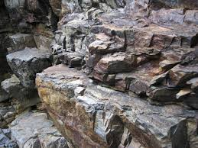
Question 1
Describe this matter
Notes:
Grey
not flammable
no conductible
density big
not ductile
not malleable
etc etc

Slide 59
Question 2
Describe this matter
Notes:
Brown white
eatable
flammable
not mattable
not conductabl e

Slide 60
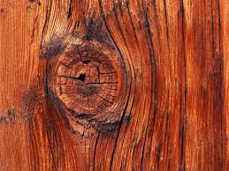
Question 3
Describe this matter
Notes:
Flammable
brown
cannot conduct electricity
not mallatable

